Slide 1
Research Proposal
Yuanpei Chen

Slide 2
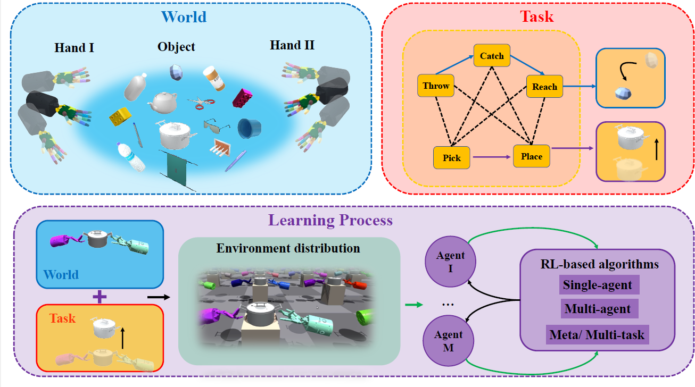
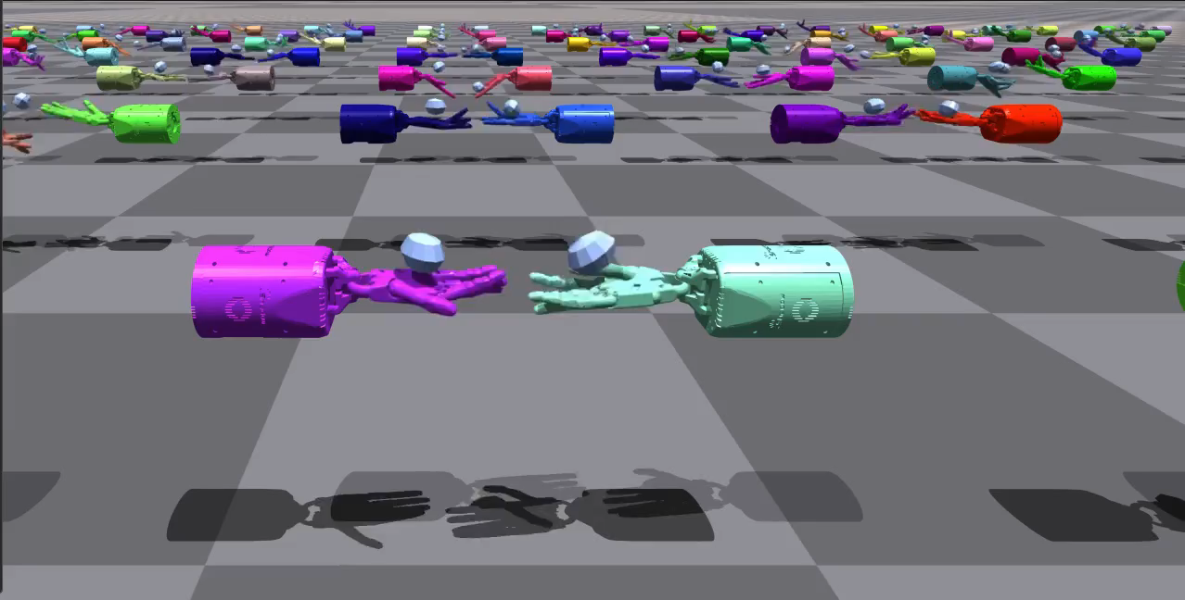
Bi-DexHands: Bimanual Dexterous Manipulation with RL
Isaac Efficiency：Using IsaacGym for parallel environment simulation, greatly improves the sampling efficiency of reinforcement learning algorithms.
RL/MARL Benchmark： We provide the first bimanual manipulation task environment for common RL, MARL, offline RL, multi-task RL, and Meta RL practitioners, along with a comprehensive benchmark for SOTA continuous control model-free RL methods.
Task Generalization：We introduced a variety of dexterous manipulation tasks (e.g., hand over, lift up, throw, place, put...) as well as enormous target objects from the YCB and SAPIEN dataset, thus allowing meta-RL and multi-task RL algorithms to be tested on the task generalization front.
…
For more information, please refer to the github repository：https://github.com/PKU-MARL/DexterousHands

Slide 3
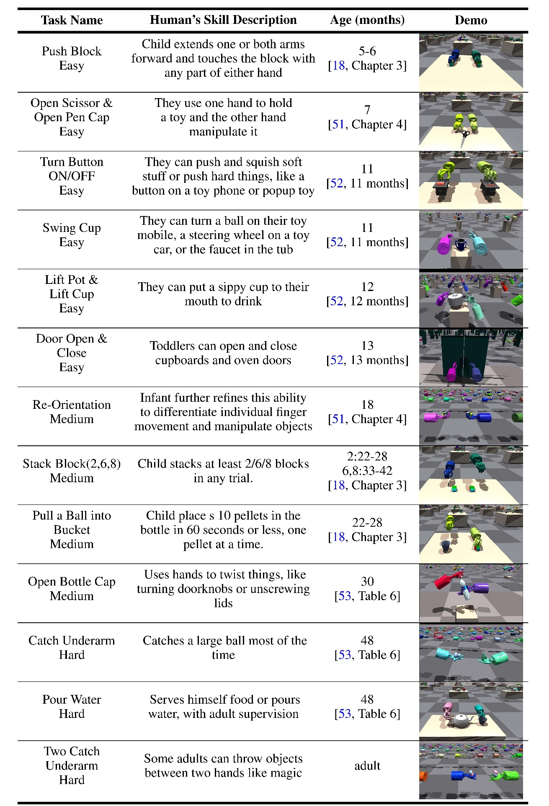
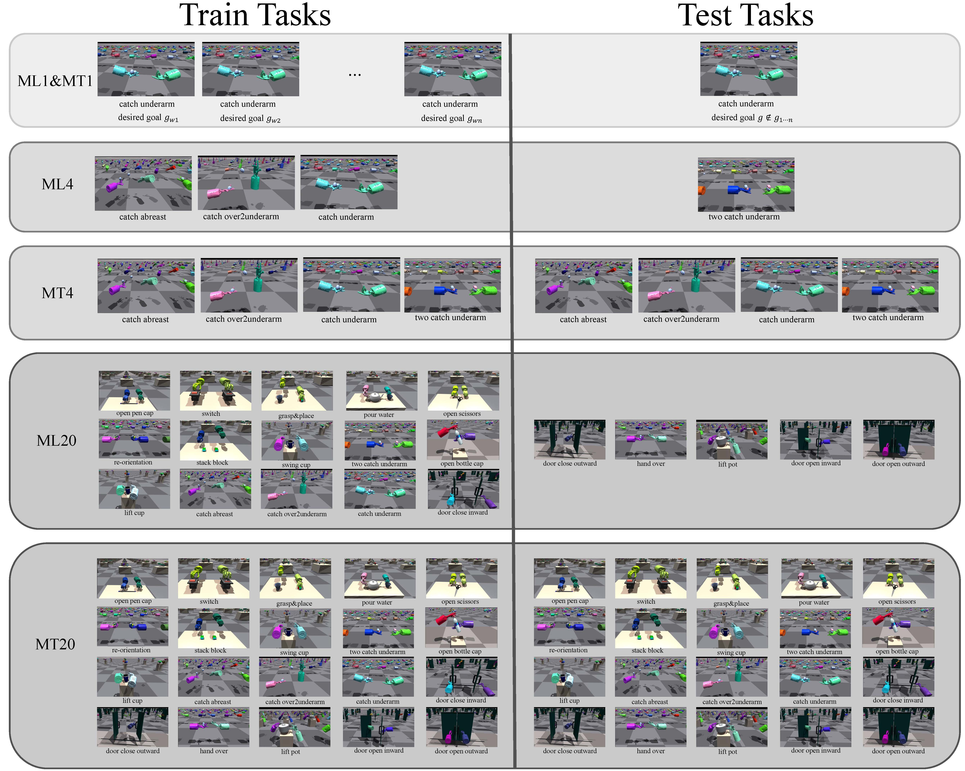
Bi-DexHands: Bimanual Dexterous Manipulation with RL

Slide 4
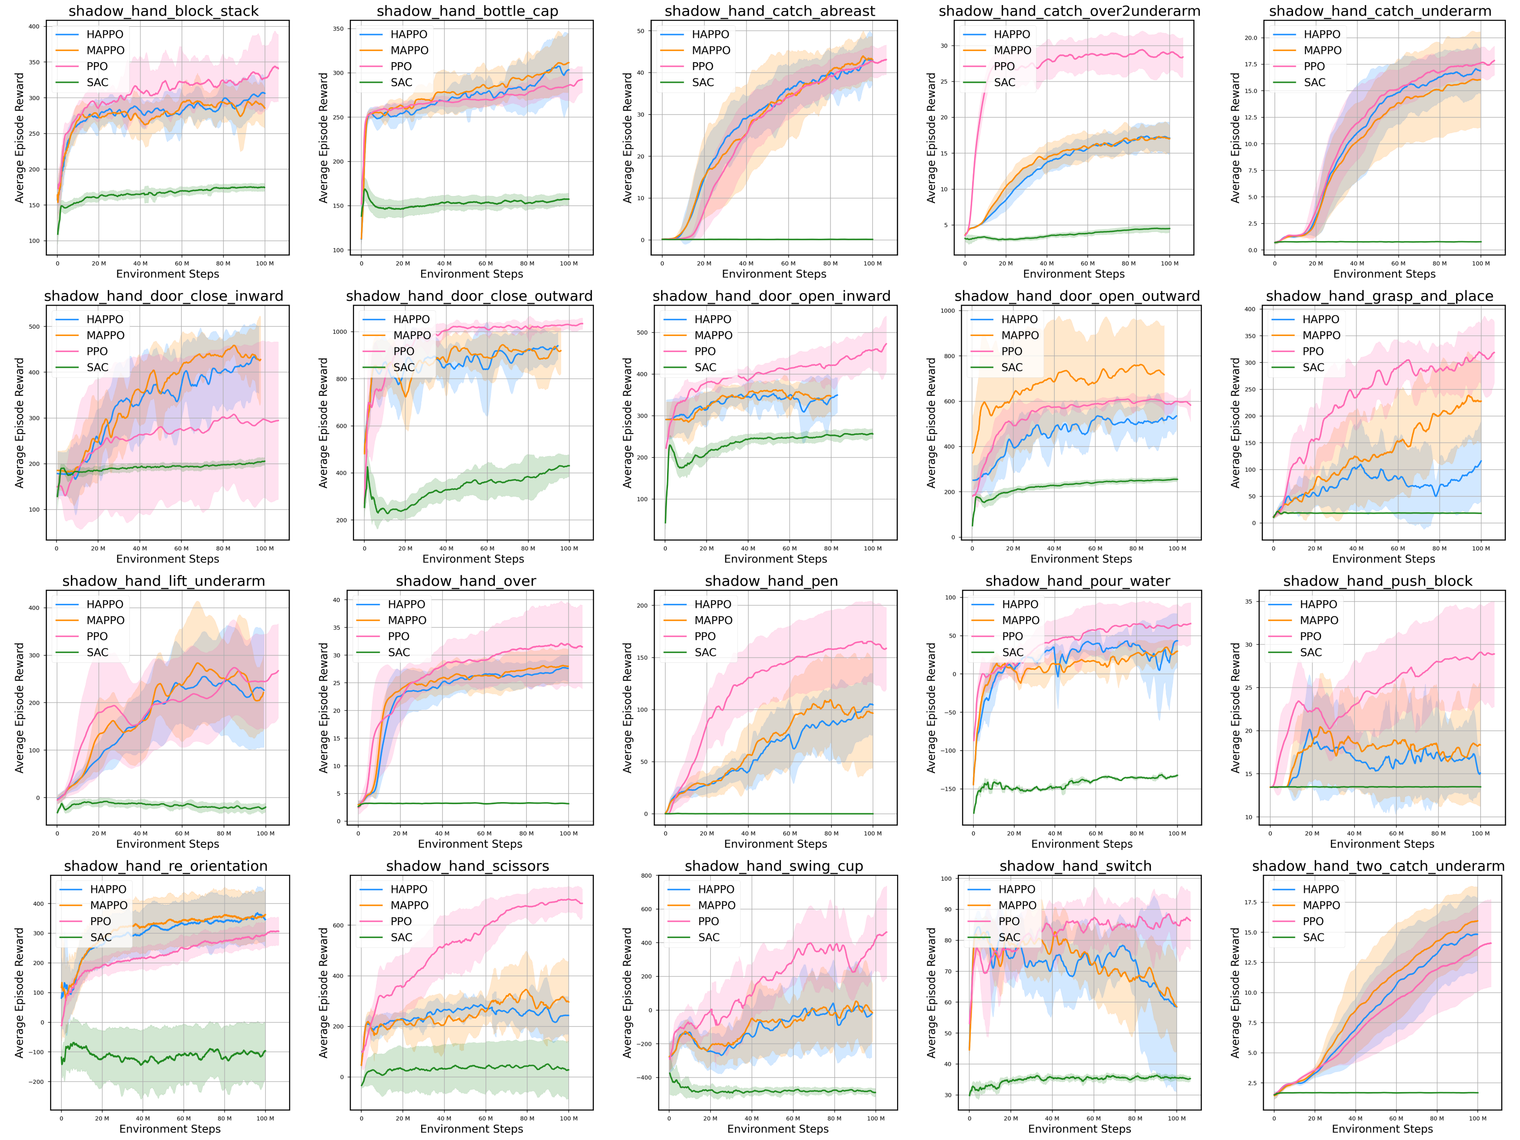
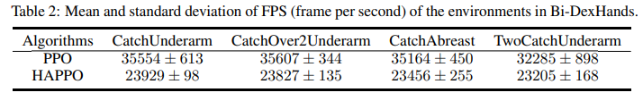
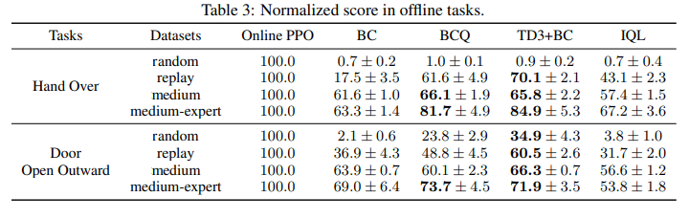
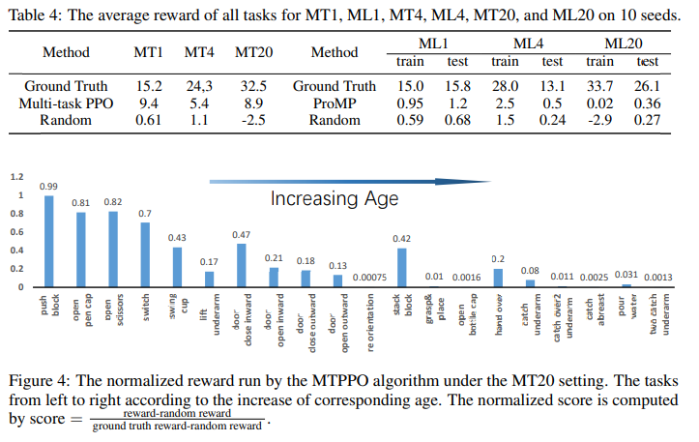
Bi-DexHands: Bimanual Dexterous Manipulation with RL

Slide 5
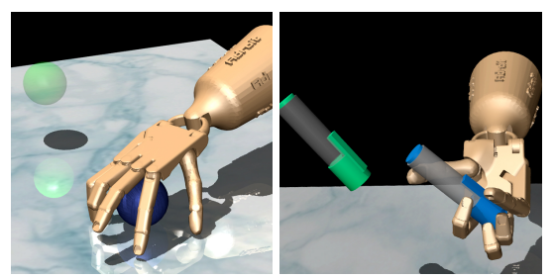
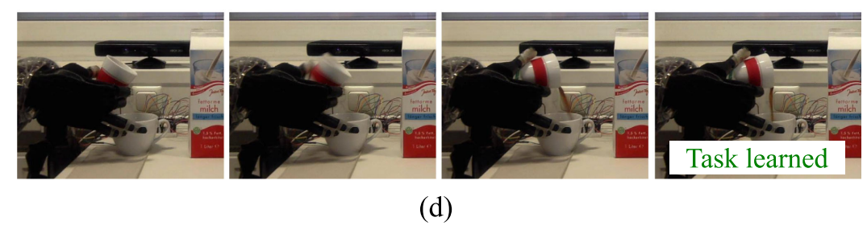
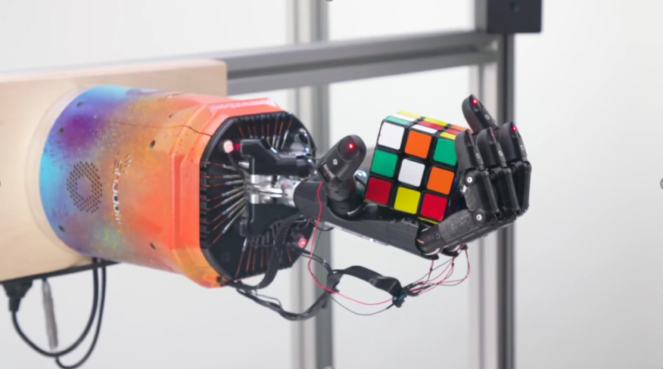
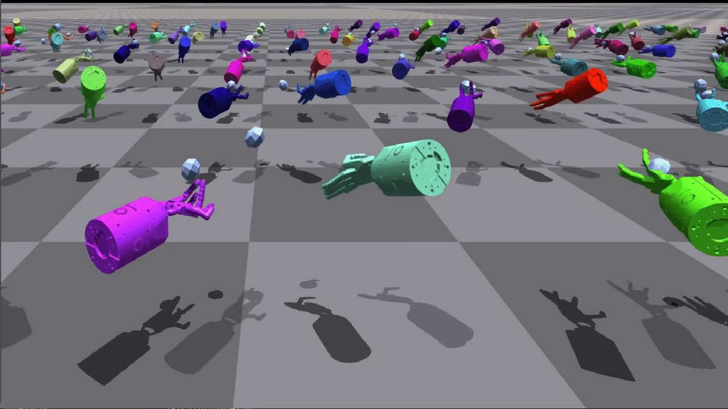
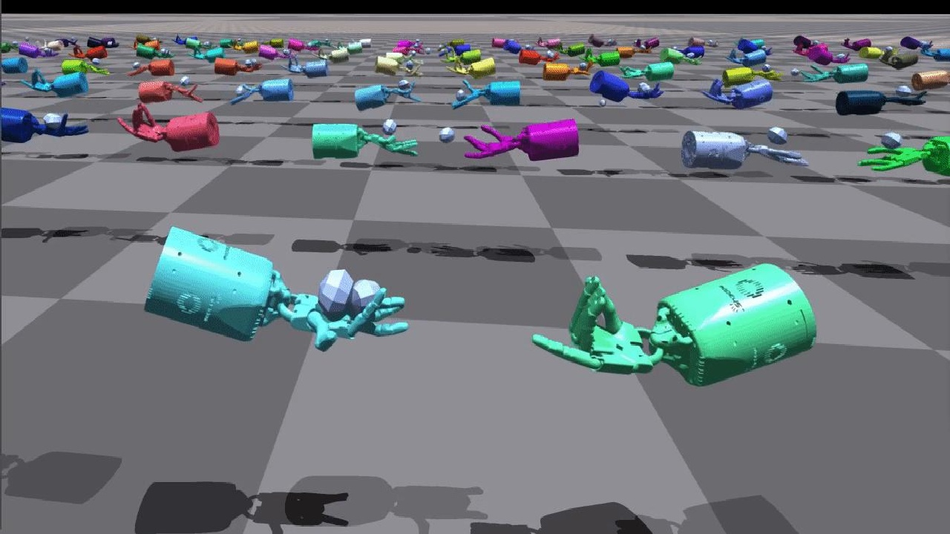
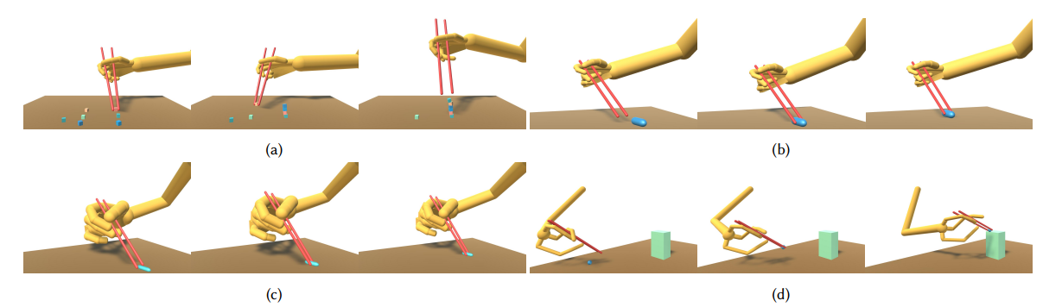
Trends and challenges in robot manipulation
---- Learning for dexterous manipulation
From Bayley Scales of Infant Development: Third Edition | SpringerLink:
Basic skills
Precise control
Finger dexterity
Dynamic interaction (ours)
Tool use

Slide 6
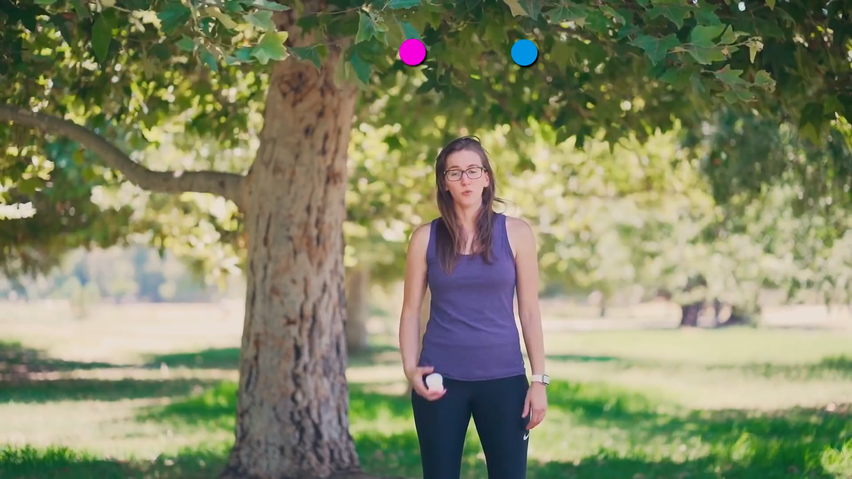
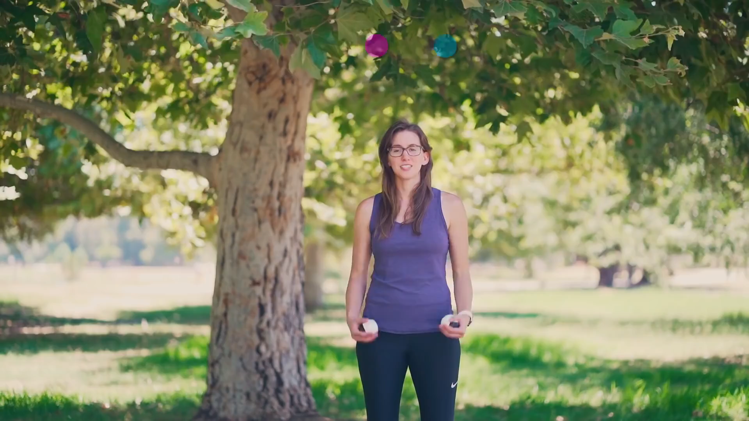
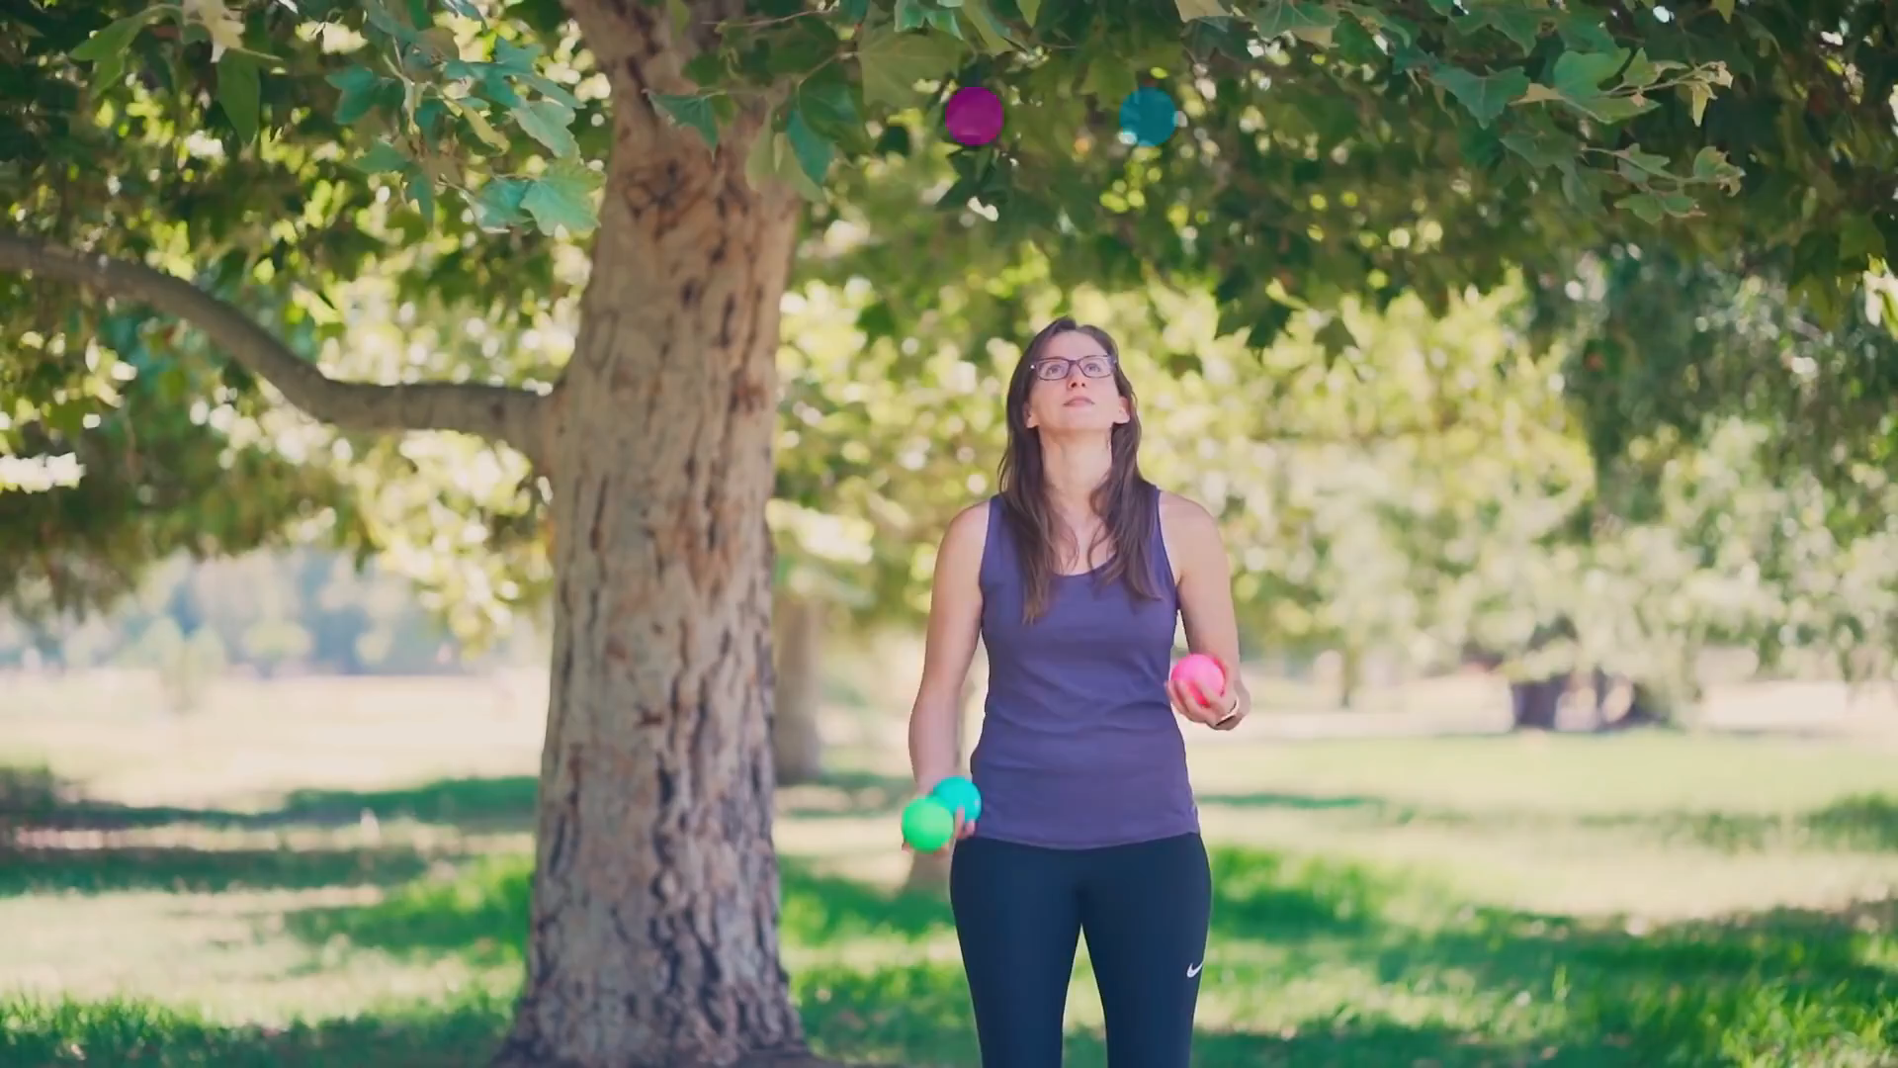
Learn to Juggle 3 Balls
1 ball
Learn how to juggle 3 balls with professional juggler Taylor Glenn! In-depth explanations, tips, and troubleshooting to help you learn to juggle like an awesome person.
Learn to JUGGLE 3 BALLS - Beginner Tutorial - YouTube
2 balls
3 balls

Slide 7


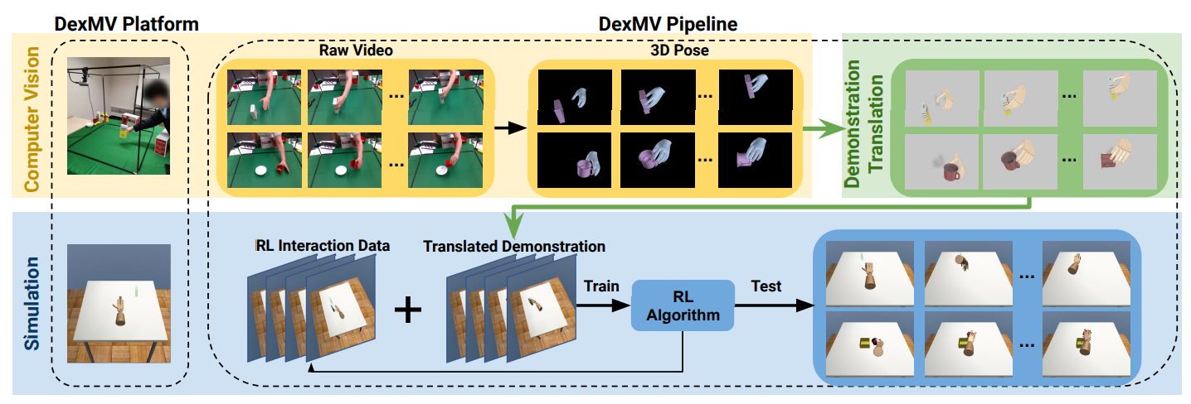
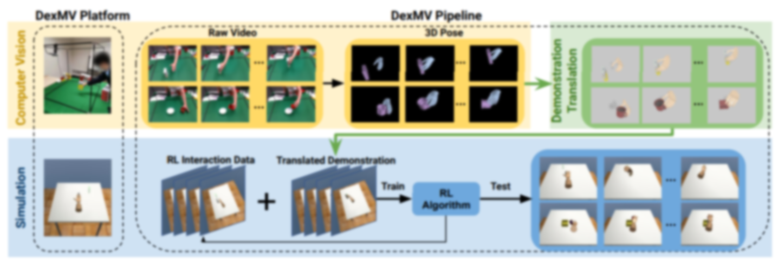
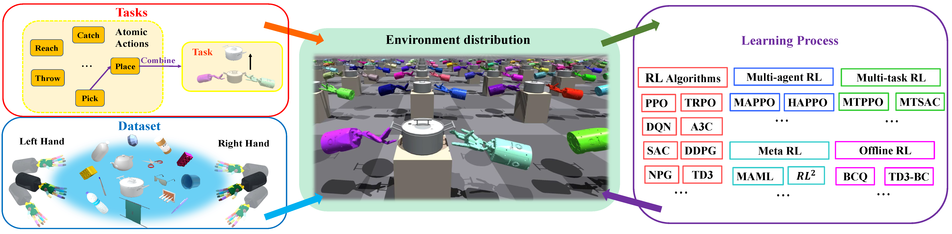
Learning
Pipeline
Other technologies
that may be useful:
Affordance
Hierarchical RL
DAPG
Multi-Agent RL
Bi-DexHands
Mixture of Expert
Purturbation

Slide 8
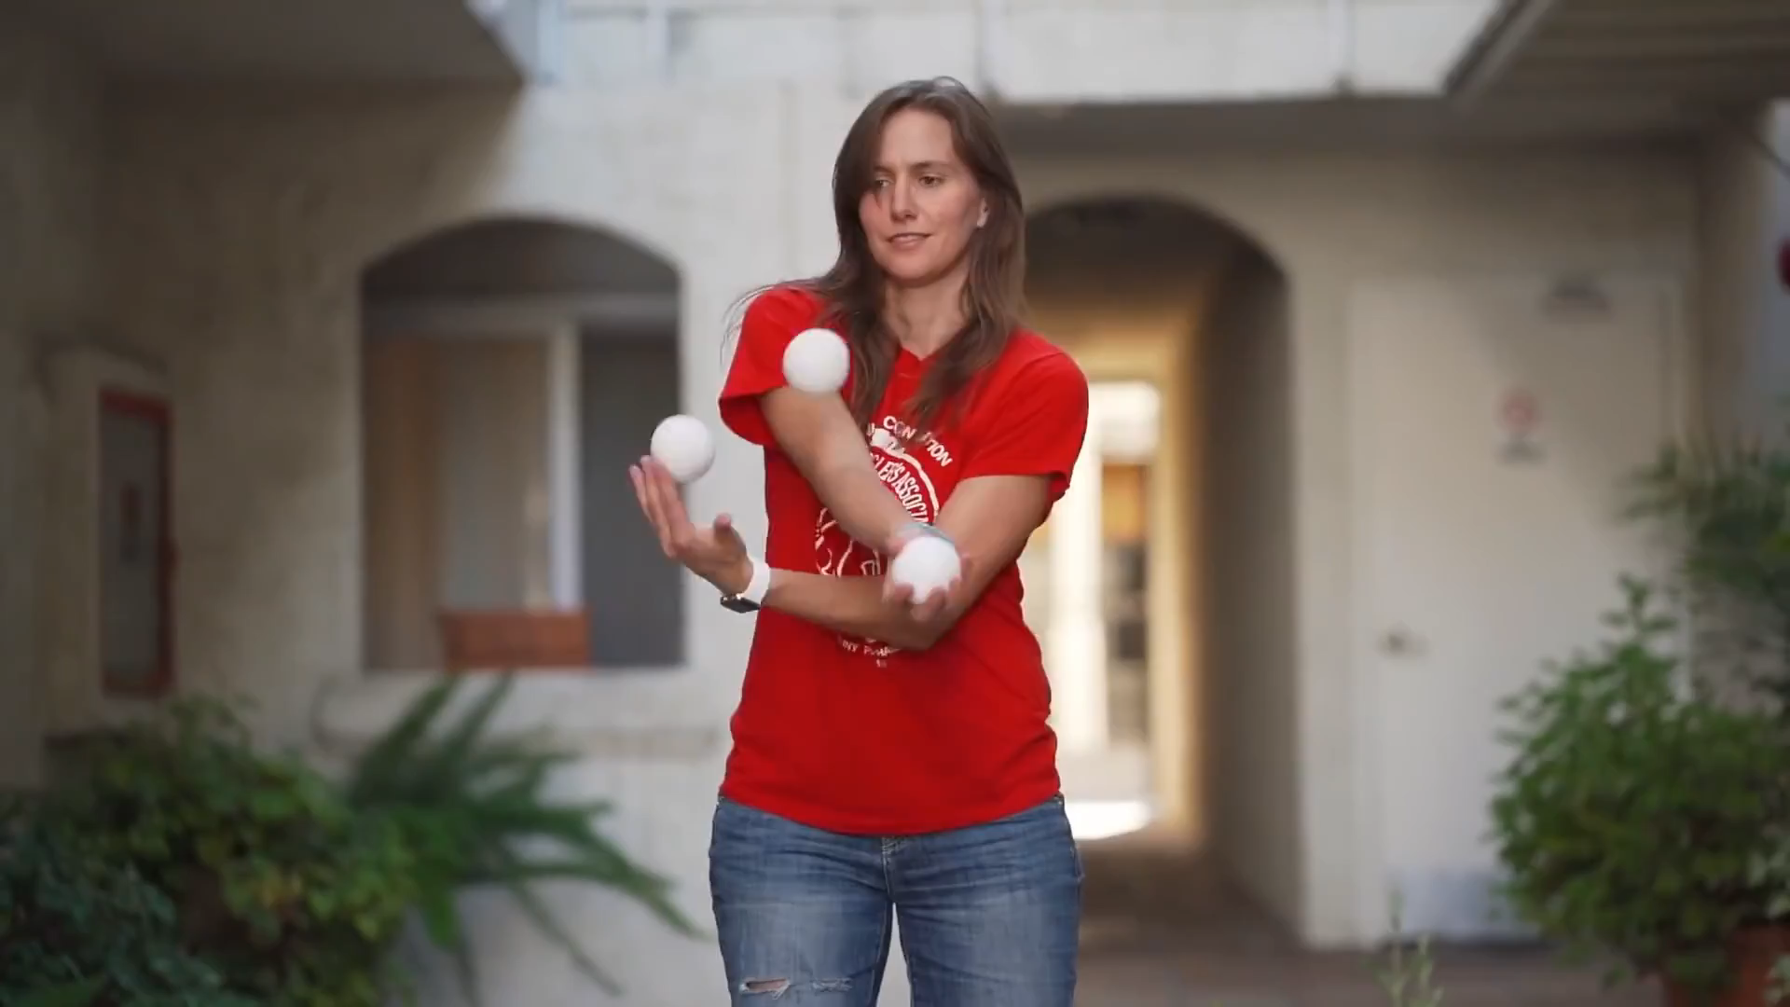
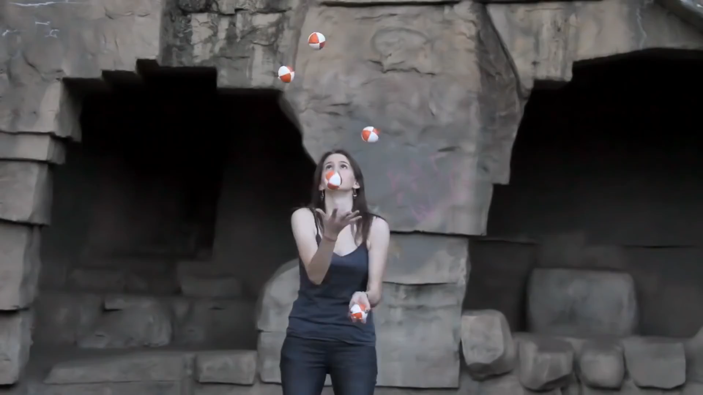
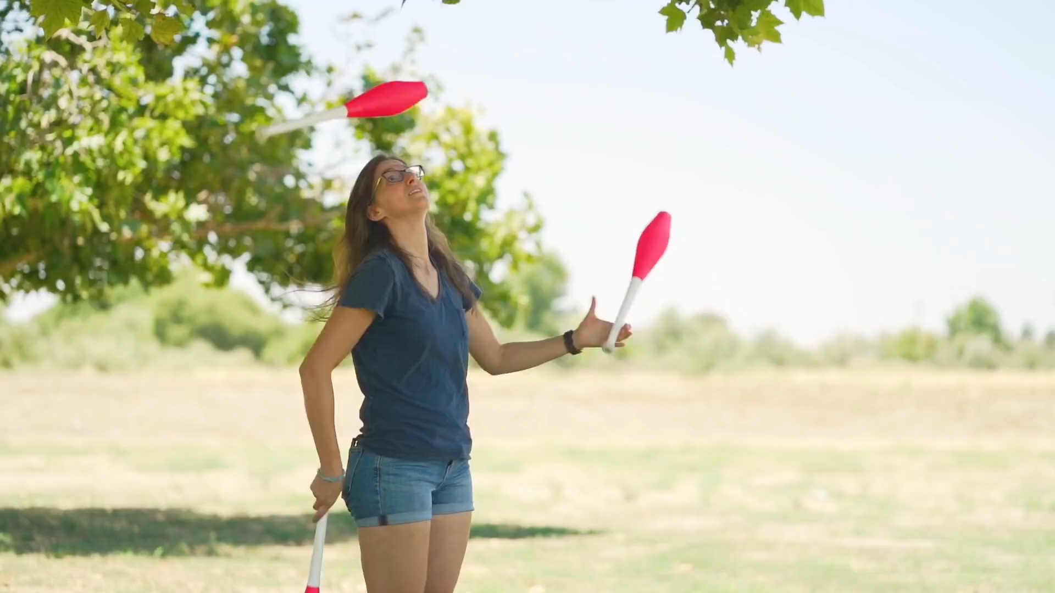
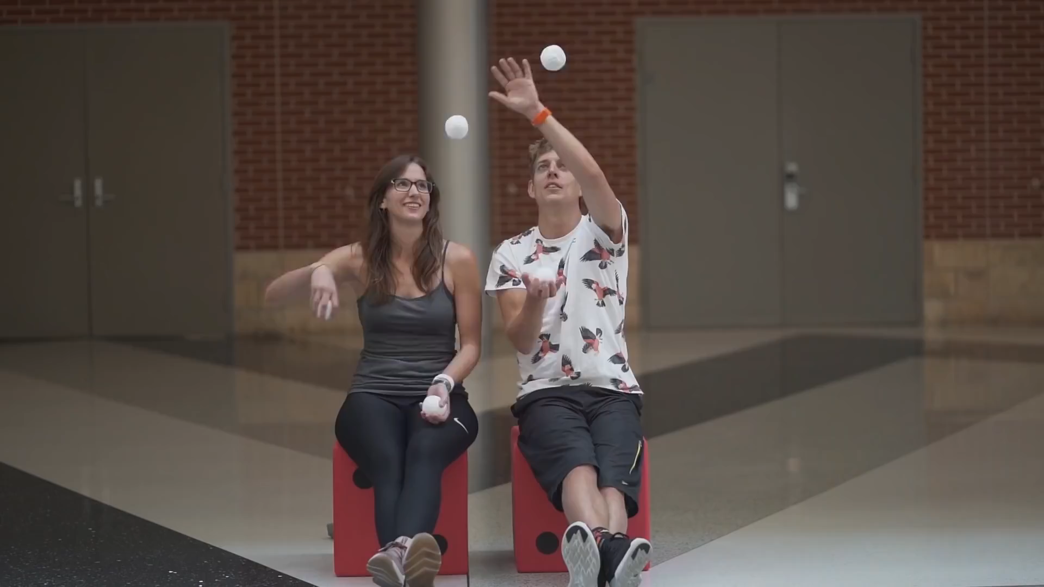
Further more
More skills
More balls
More objects
More agents

Slide 9
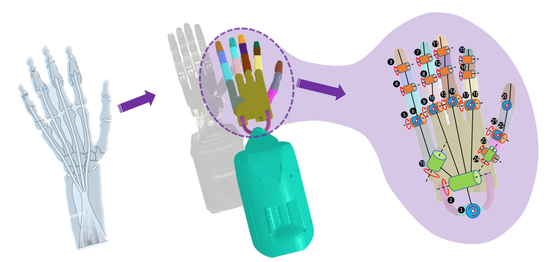
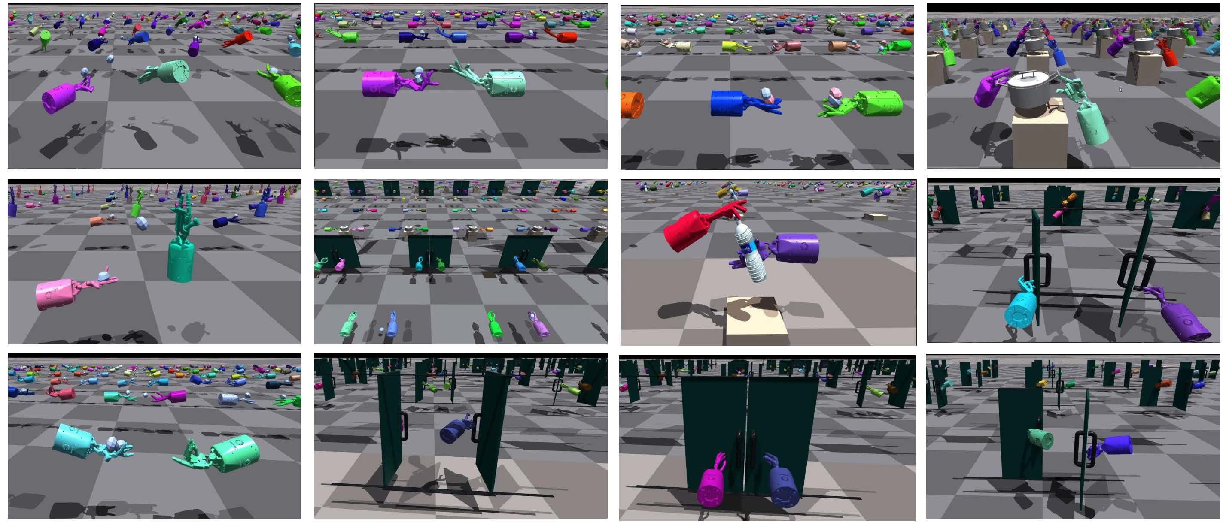
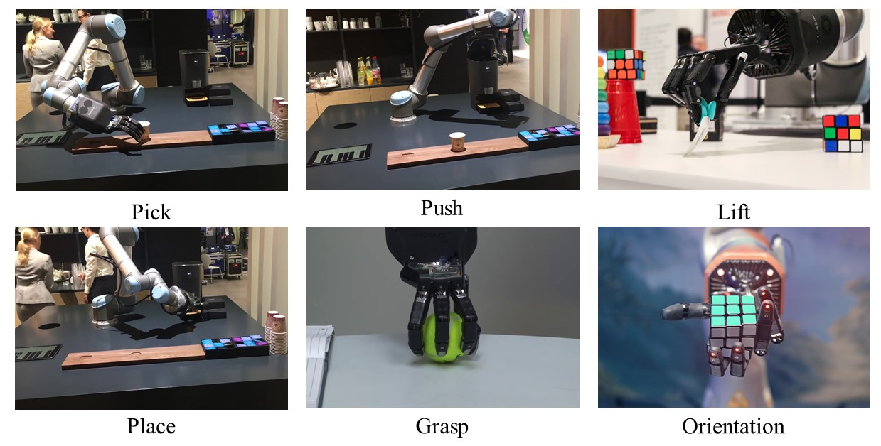
Sim2Real Transfer
Robot Dynamics Model
Training Bi-Dexterous Hand Manipulation Skills in Simulation
Training in Simulation
Real Robot Deployment
Sim2Real Method：
System Identification
Domain Randomization
Domain Adaptation
Learning with Disturbances

